Slide 1
HUNGRY HOSTEL
Presented By :-
Shraddha Akankshya - 1405428
Shubhjeet Shekhar - 1405432
Siddharth Mahapatra - 1405433

Slide 2
PROBLEM DEFINITION :-
Unavailability of food beyond restaurant specified hours.
Unavailability of homemade food.
Unavailability of less expensive food with assured quality.
No source of income for homemakers.
Lack of a business platform for homemakers with no extra significant skills.
Wastage of food and labor.

Slide 3
INNOVATION :-
Source of income with relatively less effort
Increasing employment in domestic circles
An outreach to the non-commercial sector

Slide 4
REQUIREMENT GATHERING – MIXED FORMAT QUESTIONNAIRE
Q : How often do you buy outside food (a) Almost everyday
(b) Half the month
(c) 5-10 days a month
(d) Rarely
Q : Rate your hostel mess food on a scale of 7
Q : Is it affordable to regularly purchase outside food? How budget friendly on a scale of 10?
Q : Would you purchase home-made food, if available around you ?
(a) Everyday
(b) Most of the days
(c) Sometimes, for change of taste
(d) No, that’s boring.
Q: What do you think about an Application that can connect you to HomeChef(s) enabling you to buy home cooked food on a regular basis?

Slide 5
FUNCTIONAL REQUIREMENTS :-
1. Registration
Input – User details for a/c creation
Output – Account created
Constraints – Details entered into all fields in correct format
2. Log In
Input – ID & Password
Output – Directed to Main Page after Verification
Constraints – Filling both fields mandatory
Placing Order
Input – Customer selected/customised order details
Output – Notification to Customer & Addition of “New Order” to Homechef’s feed
Constraints – Minimum >=1 order has to be placed

Slide 6
FUNCTIONAL REQUIREMENTS (CONTINUED….):-
Accept Order
Input – Order Selection by Homechef
Output – Notification to Customer & Homechef
Constraint – Has to select >=1 order
5. What’s Cooking
Input – Dish details entered my Homechef
Output – Dish added to Feed of Customer
Constraint – Entering dish details is mandatory
Payment
Input – Customer pays using the Payment Portal
Output – Pay added to Homechef’s wallet
Constraint – Exact amount to be paid
Rating
Input – Customer’s rating on 5 stars
Output – Rating submitton
Constraint – Rating field filled with non-negative number b/w 0 & 5.

Slide 7
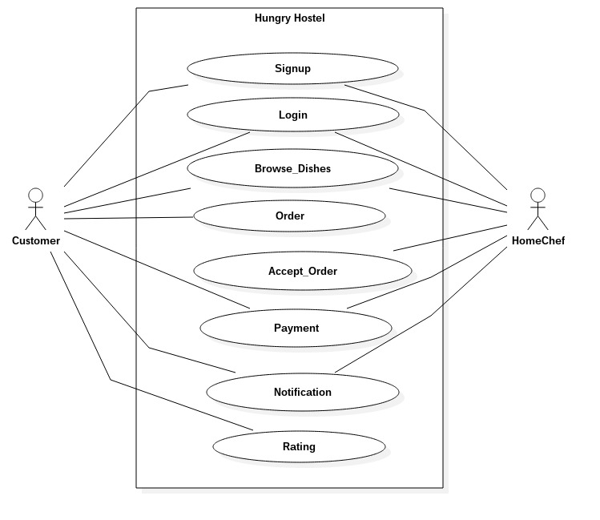
USE CASE DIAGRAM

Slide 8
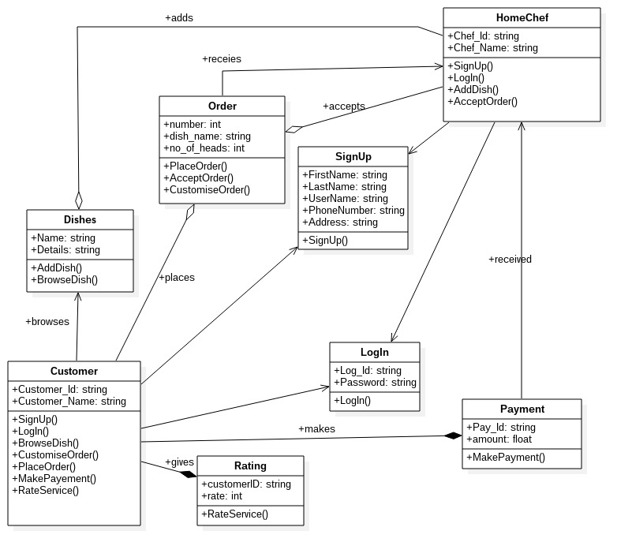
CLASS DIAGRAM

Slide 9
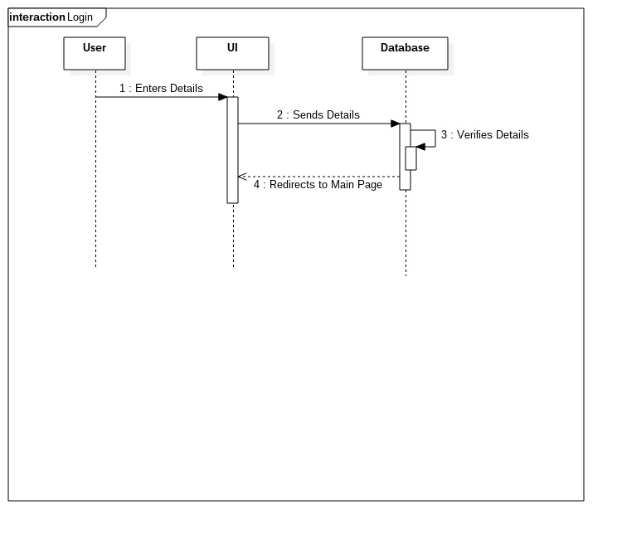
SEQUENCE DIAGRAM - 1

Slide 10
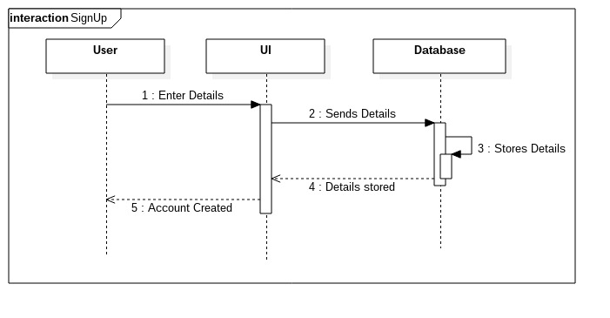
SEQUENCE DIAGRAM - 2

Slide 11
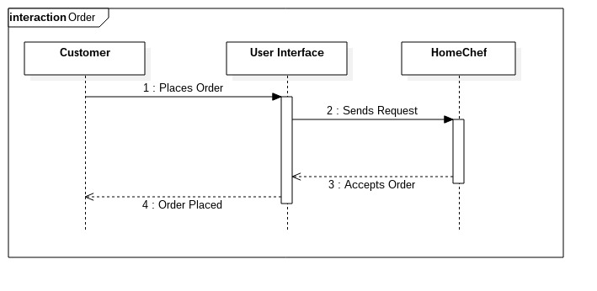
SEQUENCE DIAGRAM - 3

Slide 12
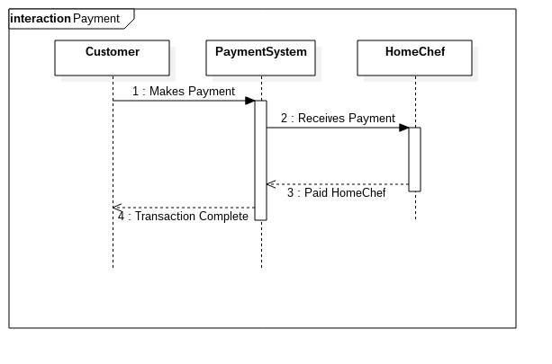
SEQUENCE DIAGRAM - 4

Slide 13
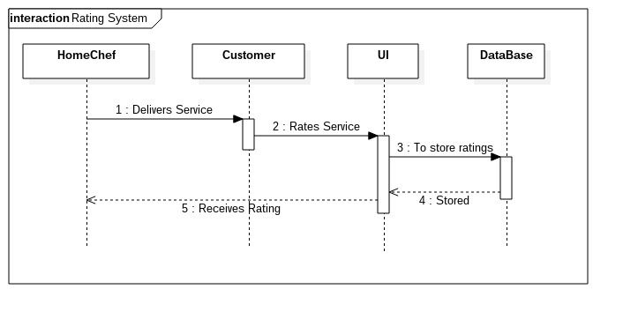
SEQUENCE DIAGRAM - 5

Slide 14
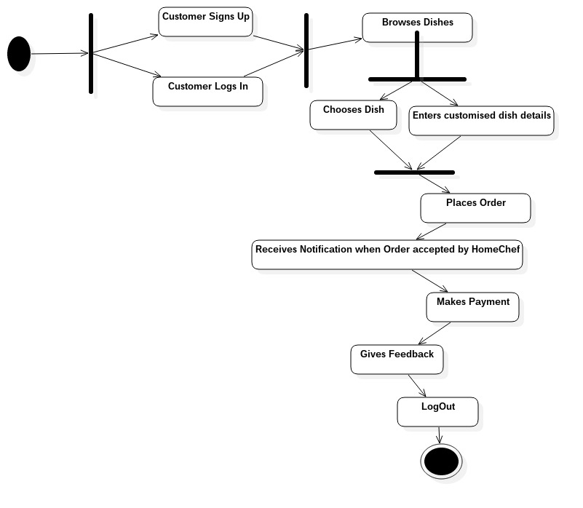
ACTIVITY DIAGRAM – 1 (CUSTOMER)

Slide 15
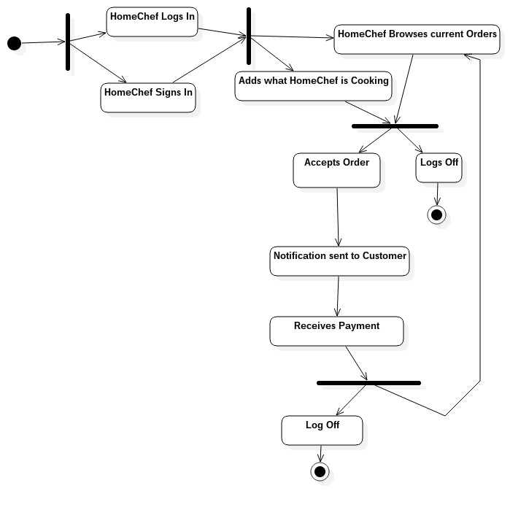
ACTIVITY DIAGRAM – 2 (HOME CHEF)

Slide 16
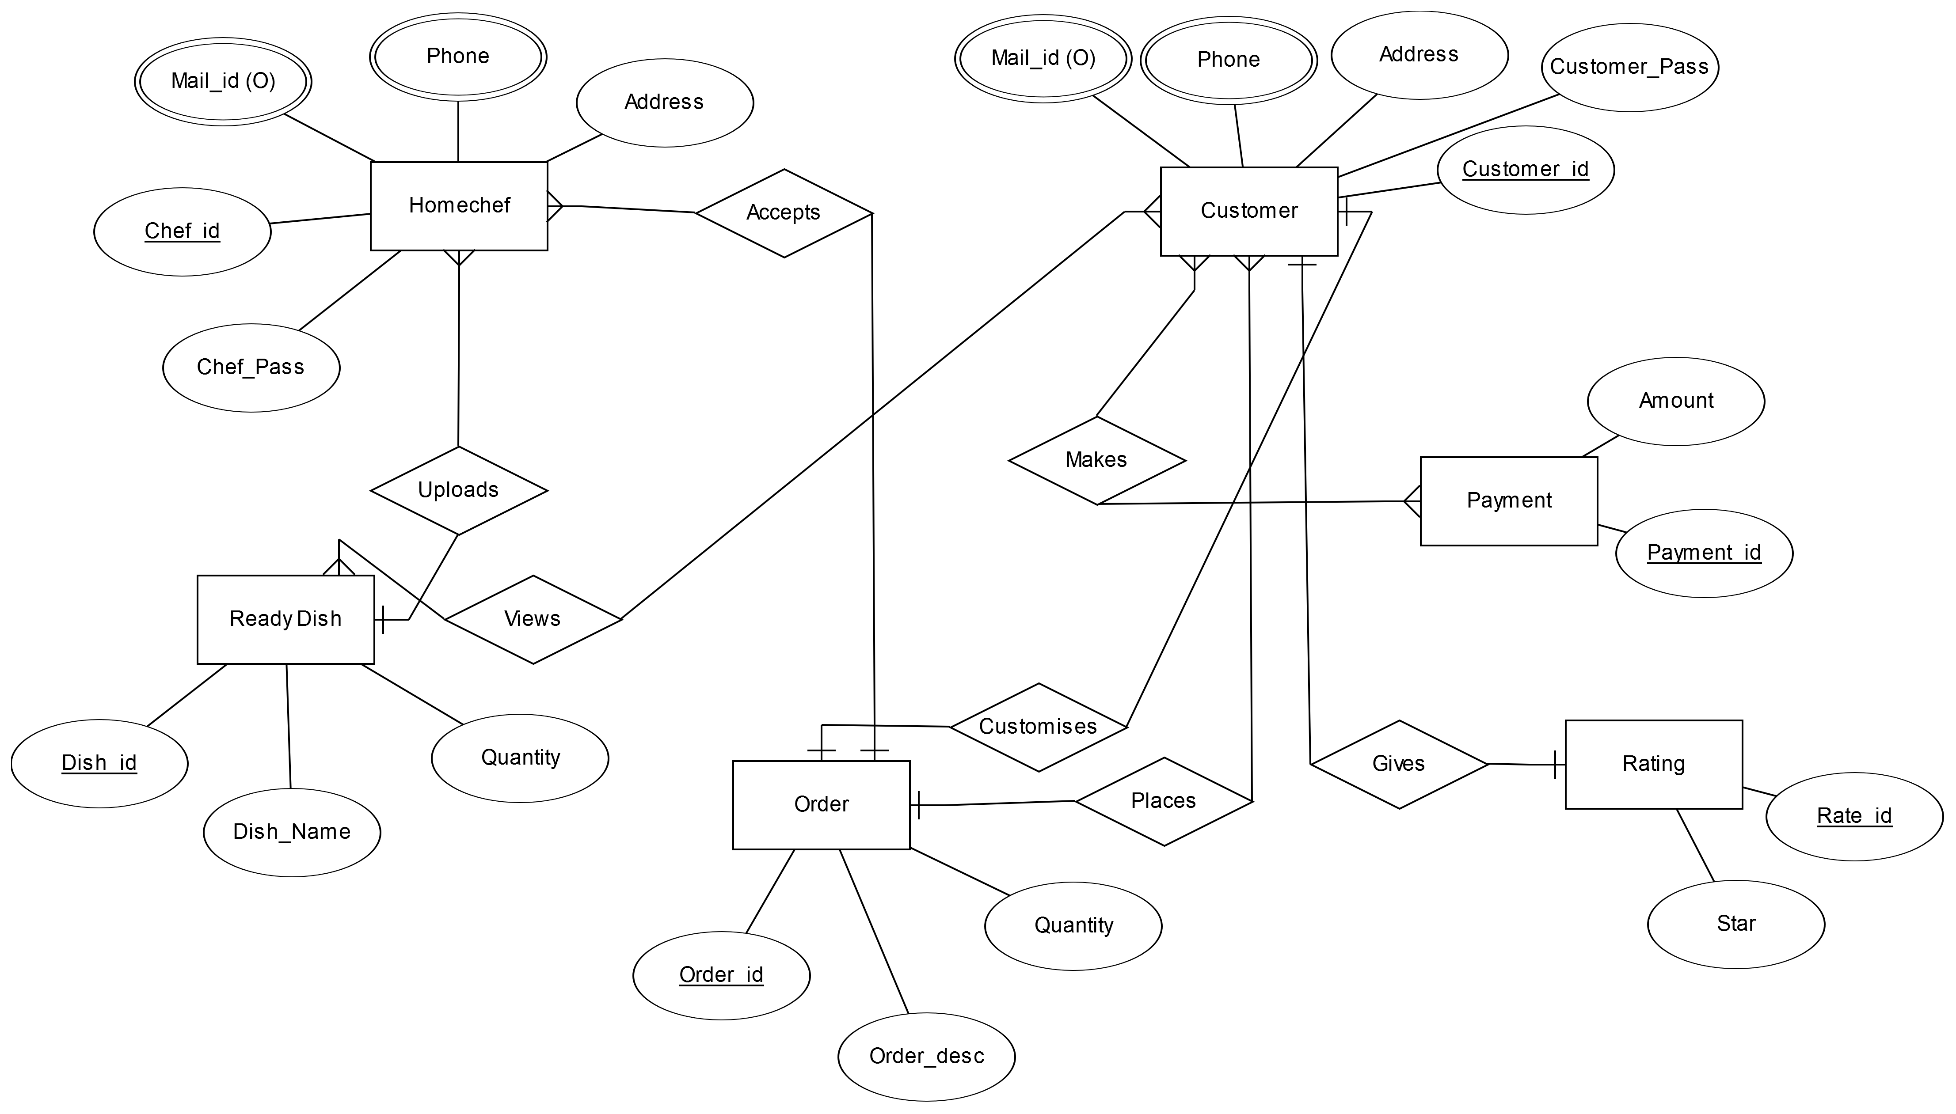
ER DIAGRAM

Slide 17
TECHNOLOGY STACK USED :- LAMP
What is LAMP ?
LAMP is an archetypal model of web service stacks, named as an acronym of the names of its original four open-source components.
The Linux operating system,
The Apache HTTP Server,
The MySQL relational database management system (RDBMS), and
The PHP programming language.
The LAMP components are largely interchangeable and not limited to the original selection. As a solution stack, LAMP is suitable for building dynamic web sites and web applications.

Slide 18
FUTURE PROSPECTS :-
Google Map API(s)
Payment System :- E-wallet(s), Net Banking
Developing an Android Application for the same.

Slide 19
REFERENCES :-
Quora - Topic ‘Uber For X’
FoodPanda.com
Zomato.com
Uber.com
Web Tech - (i) w3schools.com
(ii) bento.io
(iii) freecodecamp.com

Slide 20
SCHEDULE CHART :-
Front End – 5 days. (10-03-2017 to 14-03-2017)
Database – 5 days. (15-02-2017 to 19-03-2017)
Back End – 5 days. (20-03-2017 to 24-03-2017)
Simulation – 3 days. (25-03-2017 to 28-03-2017)
Testing – until submition

Slide 21
THANK YOU

